Slide 1
Introduction to Reversible Logic Synthesis
Robert Wille
Johannes Kepler University Linz, Austria
robert.wille@jku.at

Slide 2
Outline
What is Reversible Logic?
Why Reversible Logic? → Tomorrow (Applications)
How to Design of Reversible Logic?
What‘s Next?

Slide 3
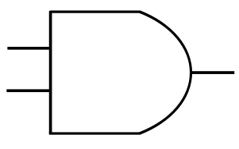
Alternative: Reversible Logic
Computations are reversible (bijective)
Same number of inputs/outputs
1:1 mapping
AND-Gate
(irreversible)
Reversible
Logic
0
1
1
0
0
X
1
1
1
1

Slide 4
Reversible Circuits
Fanout and feedback not directly allowed
Cascade of reversible gates
a
1
1
1
1
a'
1
0
1
1
b
b'
0
1
1
1
c
c'
Toffoli gate
Fredkin gate
Peres gate

Slide 5
Outline
What is Reversible Logic?
Why Reversible Logic? → Tomorrow (Applications)
How to Design of Reversible Logic?
What‘s Next?

Slide 6
How to Design Reversible Logic?
Embedding
Establish unique I/O mapping
f:B^{n}→B^{m} to be synthesized

Slide 7

The Embedding Problem
How to describe conventional logic?
Adding $\left\lceil \log{M}\right\rceil$ outputs where M is the largest number of equal output patterns
c_{in} | x | y | c_{out} | sum
0 | 0 | 0 | 0 | 0 | 0
0 | 0 | 1 | 0 | 1 | 0
0 | 1 | 0 | 0 | 1 | 1
0 | 1 | 1 | 1 | 0 | 0
1 | 0 | 0 | 0 | 1 | ?
1 | 0 | 1 | 1 | 0 | 1
1 | 1 | 0 | 1 | 0 | ?
1 | 1 | 1 | 1 | 1 | 1

Slide 8
The Embedding Problem
a | c_{in} | x | y | c_{out} | sum | g₁ | g₂
0 | 0 | 0 | 0 | 0 | 0 | 0 | 0
0 | 0 | 0 | 1 | 0 | 1 | 0 | 0
0 | 0 | 1 | 0 | 0 | 1 | 0 | 1
0 | 0 | 1 | 1 | 1 | 0 | 0 | 0
0 | 1 | 0 | 0 | 0 | 1 | 1 | 0
0 | 1 | 0 | 1 | 1 | 0 | 0 | 1
0 | 1 | 1 | 0 | 1 | 0 | 1 | 0
0 | 1 | 1 | 1 | 1 | 1 | 0 | 0
1 | 0 | 0 | 0 | 0 | 0 | 0 | 1
1 | 0 | 0 | 1 | 0 | 0 | 1 | 0
1 | 0 | 1 | 0 | 0 | 0 | 1 | 1
1 | 0 | 1 | 1 | 0 | 1 | 1 | 1
1 | 1 | 0 | 0 | 1 | 0 | 1 | 1
1 | 1 | 0 | 1 | 1 | 1 | 0 | 1
1 | 1 | 1 | 0 | 1 | 1 | 1 | 0
1 | 1 | 1 | 1 | 1 | 1 | 1 | 1

Slide 9
How to Design Reversible Logic?
Embedding
Establish unique I/O mapping
Synthesis
Realize circuit for reversible function
f:B^{k}→B^{k} (embedded)
f:B^{n}→B^{m} to be synthesized

Slide 10
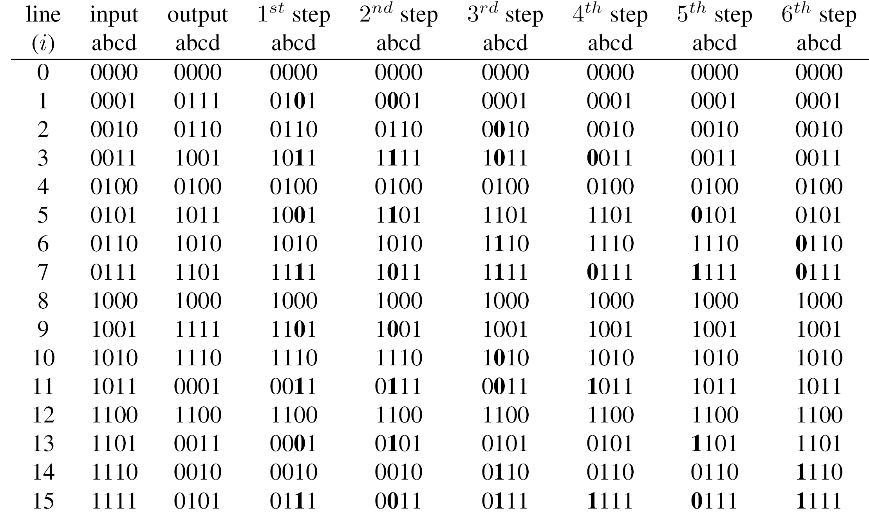
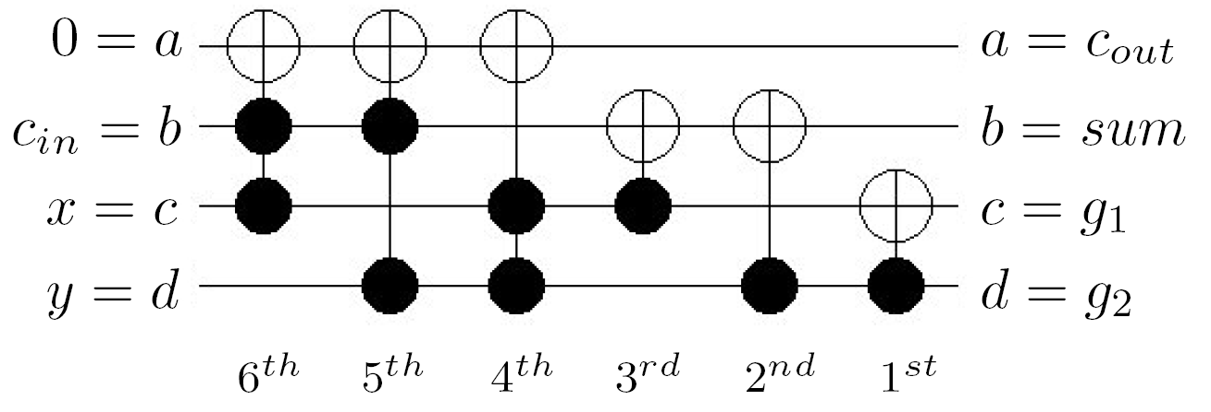
Synthesis

Slide 11
Synthesis

Slide 12
How to Design Reversible Logic?
Embedding
Establish unique I/O mapping
Synthesis
Realize circuit for reversible function
f:B^{k}→B^{k} (embedded)
f:B^{n}→B^{m} to be synthesized
Direct Synthesis
Realize circuit for arbitrary function

Slide 13
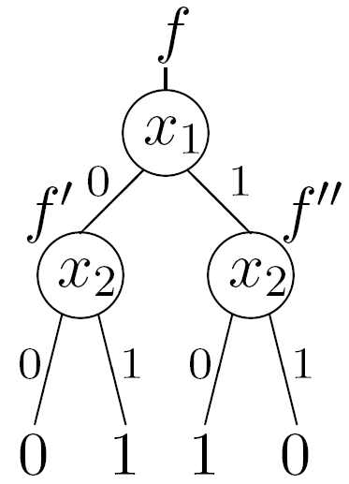
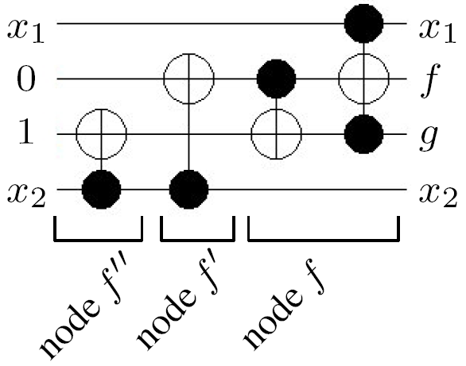
Direct Synthesis

Slide 14
How to Design Reversible Logic?
Embedding
Establish unique I/O mapping
Synthesis
Realize circuit for reversible function
f:B^{k}→B^{k} (embedded)
f:B^{n}→B^{m} to be synthesized
Direct Synthesis
Realize circuit for arbitrary function
HDL-based Synthesis
Realize circuit for reversible HDL

Slide 15
HDL-based Synthesis
Reversible assignment operations
Binary operations
a=4
a += 5
a=9
a=4 b=5 a=2 b=10
a*b
a * b = 20
a=4 b=5 c=0
c+=a*b
a=4 b=5 c=20
X

Slide 16
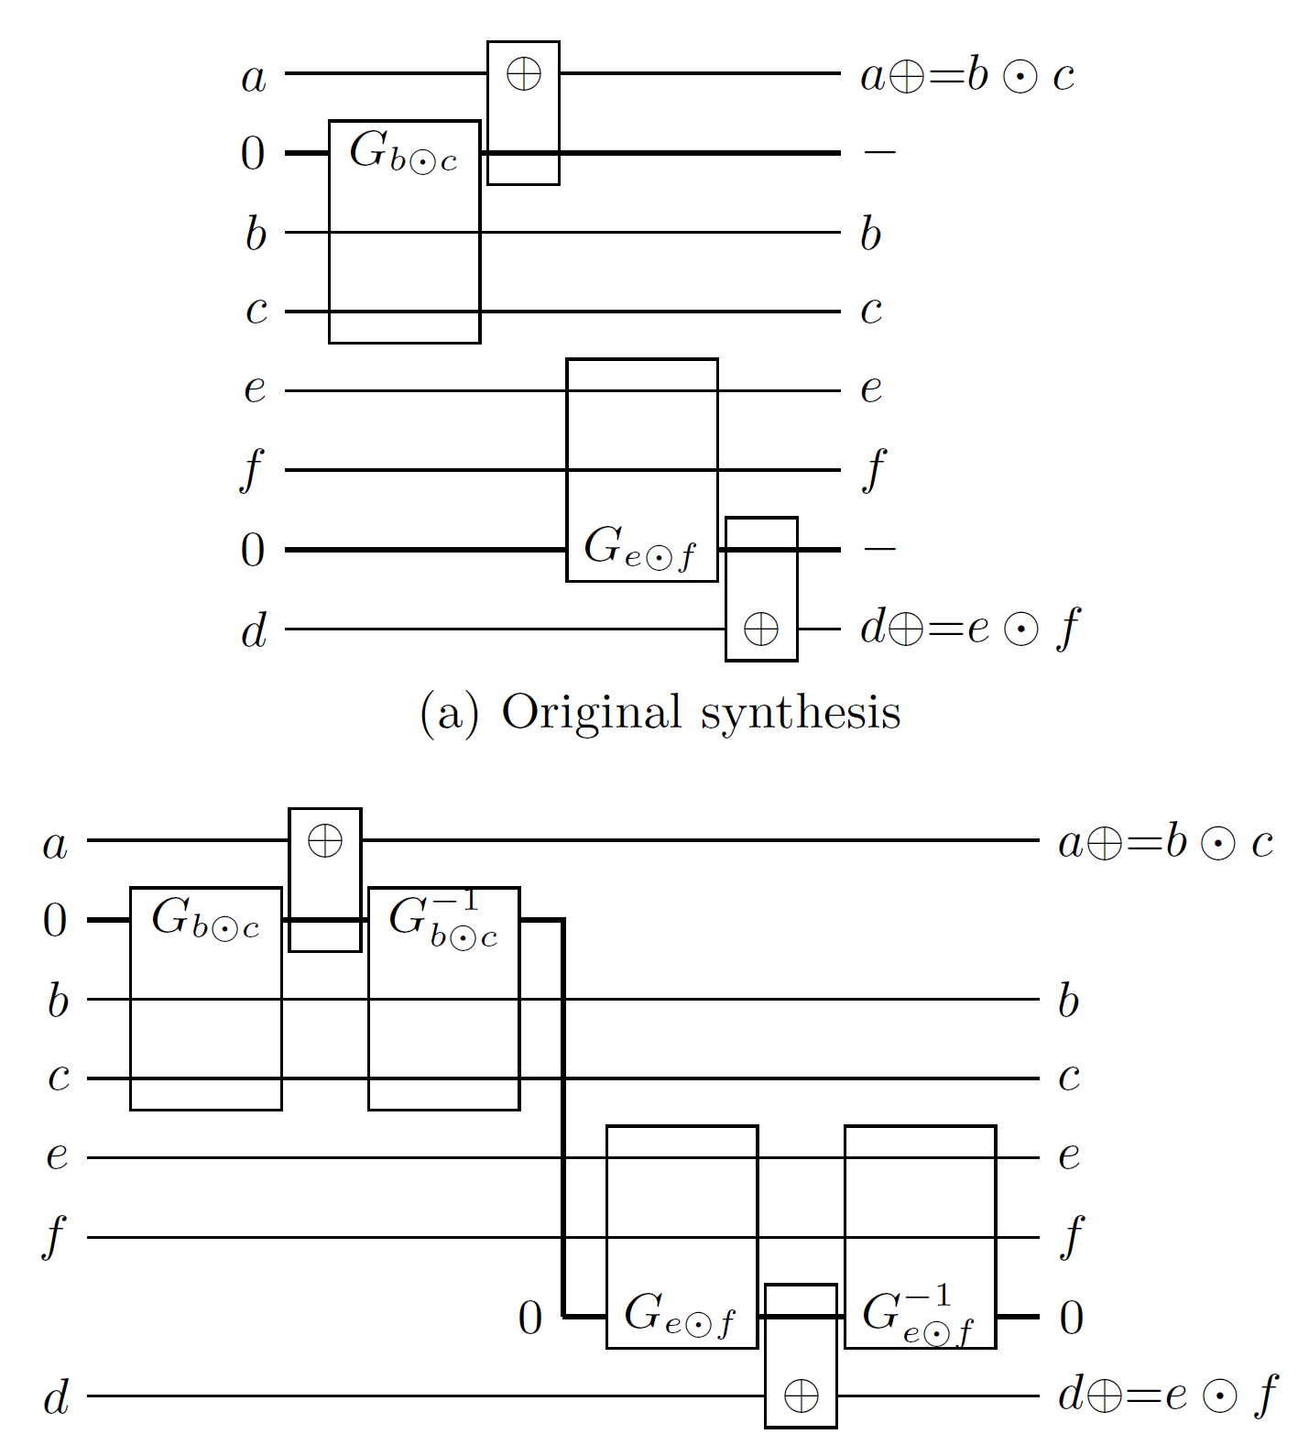
HDL-based Synthesis

Slide 17
Outline
What is Reversible Logic?
Why Reversible Logic? → Tomorrow (Applications)
How to Design of Reversible Logic?
What‘s Next?

Slide 18
Summary: Design of Reversible Circuits
Embedding
Establish unique I/O mapping
Functional Synthesis
Realize circuit for reversible function
f:B^{k}→B^{k} (embedded)
f:B^{n}→B^{m} to be synthesized
Drawbacks:
Embedding is expensive
Degree of freedom is not exploited
Exponential growth of representation
Alternative: One-pass Synthesis

Slide 19

One-pass Synthesis
Example: Transformation-based Synthesis
Start synthesis without embedding
Modify function if problem occurs
Store changes on buffer line
Revert changes after synthesis
One gate for each buffer line
Can be applied to many different synthesis approaches!

Slide 20
Summary: Design of Reversible Circuits
Embedding
Establish unique I/O mapping
Functional Synthesis
Realize circuit for reversible function
f:B^{k}→B^{k} (embedded)
One-Pass Synthesis
Conduct both tasks in a single step
f:B^{n}→B^{m} to be synthesized
Structural/Hierarchical Synthesis
Map function to reversible circuit
Alternative data-structures?

Slide 21
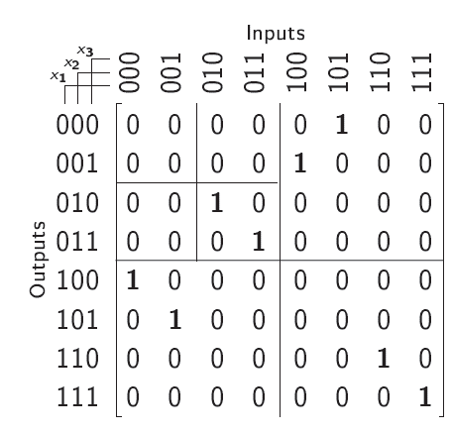
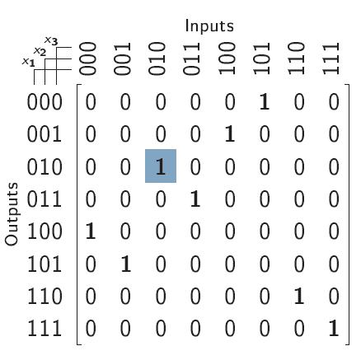
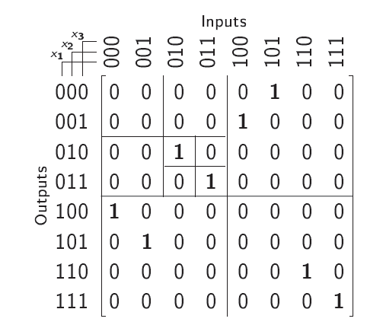
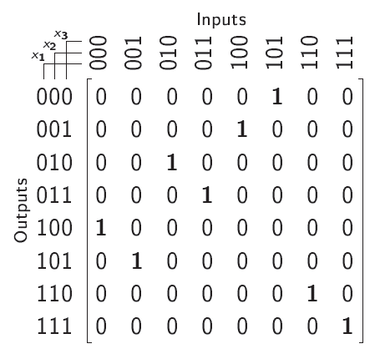
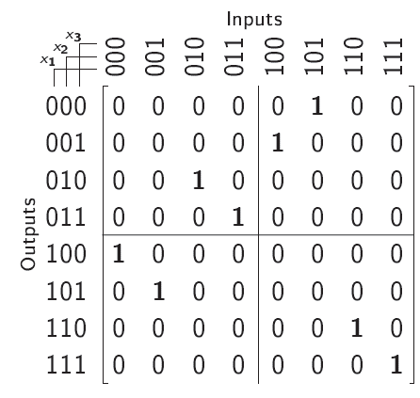
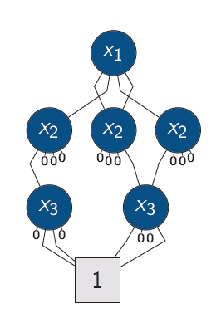
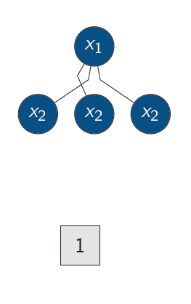
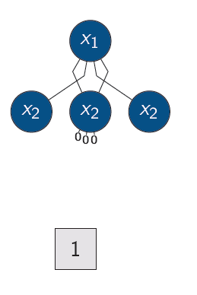
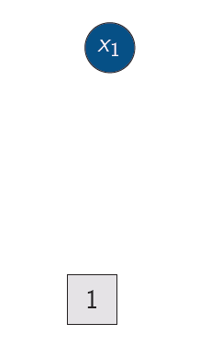
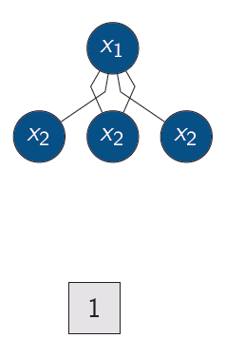
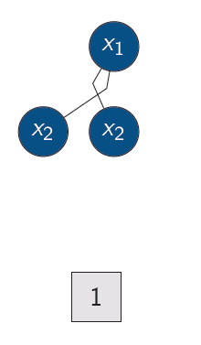
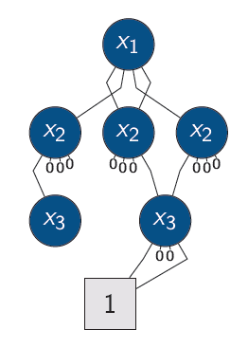
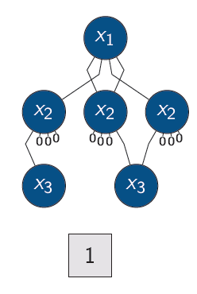
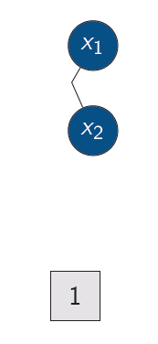
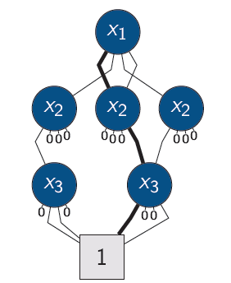
Representation of Reversible Functions
Quantum Multiple-valued Decision Diagrams (publicly available at http://www.informatik.uni-bremen.de/agra/eng/qmdd.php)

Slide 22
Adjusted Design of Reversible Circuits
Work with permutation matrices!
Suitable representation for reversible functionality
Can efficiently be represented and manipulated using QMDDs

Slide 23
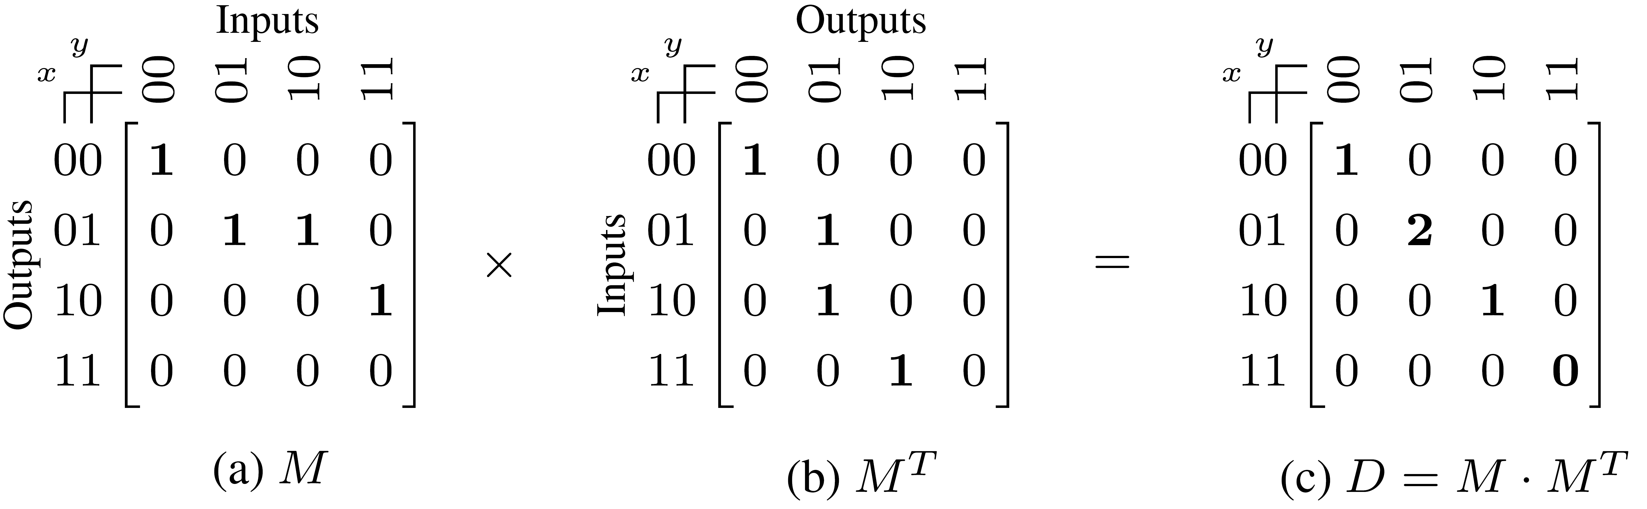
Example: Determination of #Garbage
Determine the number of garbage outputs
Counting the number of 1‘s in all rows
Equal to multiplying matrix M with transposition of M

Slide 24
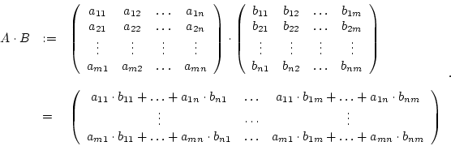
Review: Matrix Multiplication
(c_{ij}:= row i of A and column j of B)

Slide 25
Example: Determination of #Garbage
Determine the number of garbage outputs
Counting the number of 1‘s in all rows
Equal to multiplying matrix M with transposition of M

Slide 26
QMDDs: Further Applications
Embedding
Synthesis
Verification
Simulation
…

Slide 27
Summary: Design of Reversible Circuits
Embedding
Establish unique I/O mapping
Functional Synthesis
Realize circuit for reversible function
f:B^{k}→B^{k} (embedded)
One-Pass Synthesis
Conduct both tasks in a single step
f:B^{n}→B^{m} to be synthesized
Structural/Hierarchical Synthesis
Map function to reversible circuit
Application of further data-structures such as QMDDs
HDL-based Synthesis
Realize circuit for reversible HDL

Slide 28
HDL-based Synthesis
Distinction between reversible assignment operations and binary operations

Slide 29
General Observations
Reversible HDL descriptions are inherently
reversible
➔ There must be a reversible circuit with zero additional lines realizing the described functionality

Slide 30
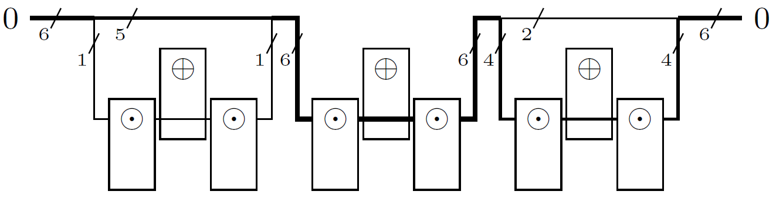
Sequence of Statements
Consider a sequence of three statements
Assume their realization requires 1, 6, and 4 additional lines
➔ Focus on optimizing the realization of the “largest” statement!

Slide 31
Simple Optimization
Intermediate results of the inner expressions must be buffered
Considering 32-bit signals, this requires 96 circuit lines
Plus 32 circuit lines to buffer the result of the outer expression
→ 128 circuit lines in total
Binary operations are applied separately with an assignment operation.
Hence, no more than 32 circuit lines are needed to buffer the intermediate results

Slide 32
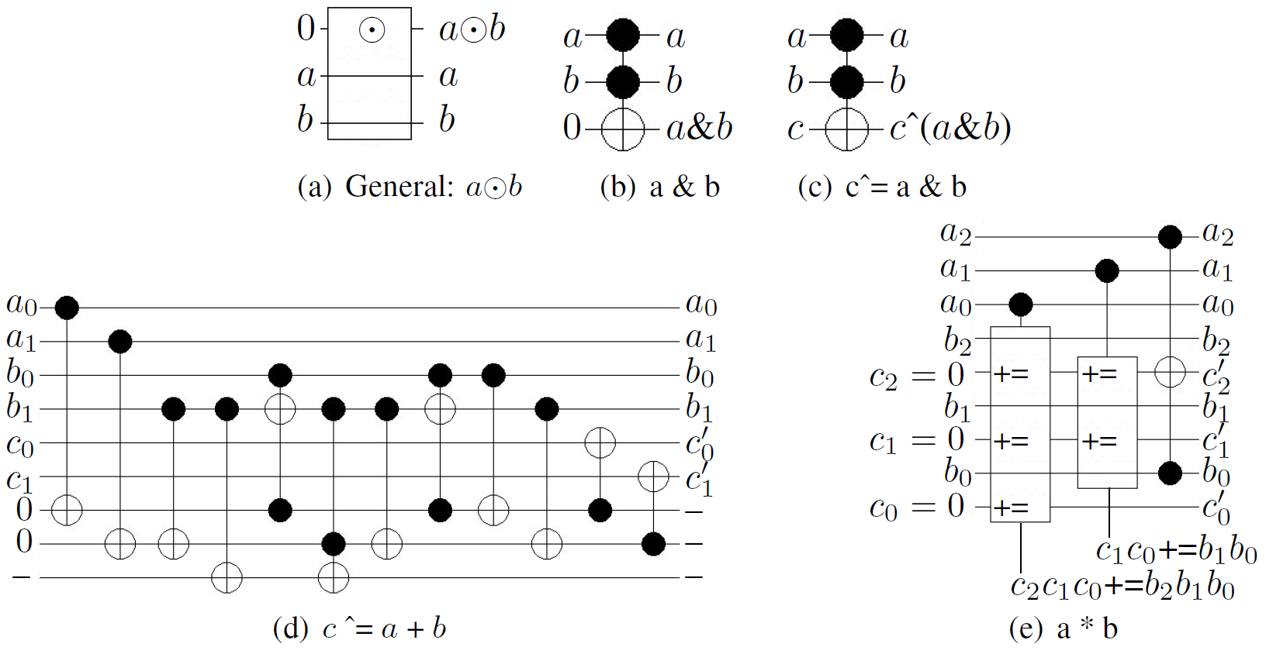
General Observations
Reversible HDL descriptions are inherently
reversible
➔ There must be a reversible circuit with zero additional lines realizing the described functionality
Thus far: The realization of the assignment and the expression is considered separately
➔ Not possible for each combination of assignment/expr.

Slide 33
Reversible HDL-based Synthesis
Scalable synthesis of efficient circuits is THE big challenge in reversible circuit design
Does not necessarily require a fully-fledged HDL-synthesizer
Not so much about generating building blocks, but using/combining them in a clever fashion
Use of techniques from compiling, term re-writing, etc.

Slide 34
Summary: Design of Reversible Circuits
Embedding
Establish unique I/O mapping
Functional Synthesis
Realize circuit for reversible function
f:B^{k}→B^{k} (embedded)
One-Pass Synthesis
Conduct both tasks in a single step
f:B^{n}→B^{m} to be synthesized
Structural/Hierarchical Synthesis
Map function to reversible circuit
Application of further data-structures such as QMDDs
HDL-based Synthesis
Realize circuit for reversible HDL
Towards HDL-based synthesis without additional circuit lines

Slide 35
Further Reading
Good overview (state-of-the-art report of the COST Action): https://github.com/COST-IC1405/wg3-soar-report/blob/master/README.md
Embedding Embedding of Large Boolean Functions for Reversible Logic, JETC 2016 Make It Reversible: Efficient Embedding of Non-reversible Functions. DATE 2017
Transformation-based Synthesis A Transformation Based Algorithm for Reversible Logic Synthesis, DAC 2003 A fast symbolic transformation based algorithm for reversible logic synthesis, RC 2016.
BDD-based Synthesis BDD-based Synthesis of Reversible Logic for Large Functions, DAC 2009
One-pass Synthesis One-pass Design for Reversible Circuits: Combining Embedding and Synthesis for Reversible Logic, TCAD 2017
QMDD Data-structure QMDDs: Efficient Quantum Function Representation and Manipulation, TCAD 2016 Implementation available at http://www.informatik.uni-bremen.de/agra/eng/qmdd.php
SyReC HDL SyReC: A Hardware Description Language for the Specification and Synthesis of Reversible Circuits, INTEGRATION 2016

